Slide 1

Internship Review

Slide 2

Company : Koch Technology Center (Koch Industries) Role Assigned: Data Engineer Mentor : Ankit Khanduri [ Data Engineer, KTC KBS Analytics]

Slide 3

What does KTC do?
Companies under Koch Industries:
Molex
Flint Hills Resources
Georgia Pacific
Guardian Industries
Infor
INVISTA
KES
KED
KTC is a global IT center for all the companies of Koch Industries

Slide 4


Project 1: Build Databases
To start a work it’s basics are essential, keeping that in mind we were given a set of conditions to build a couple of databases within a week of time.
The databases were,
Railway Management System
School Management System
The Database server used is “SQL Server”
Key Learnings:
Usage of queries to create a database and tables in it
Query the Database
Usage of many of the query standards of mysql

Slide 5
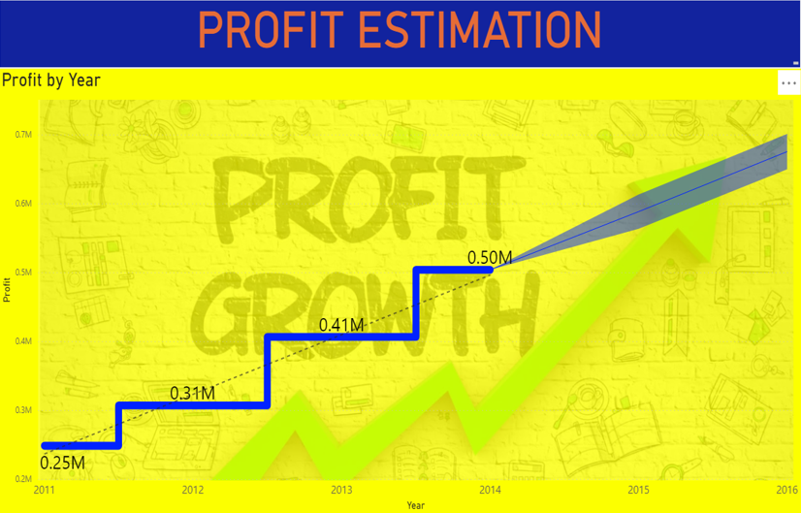
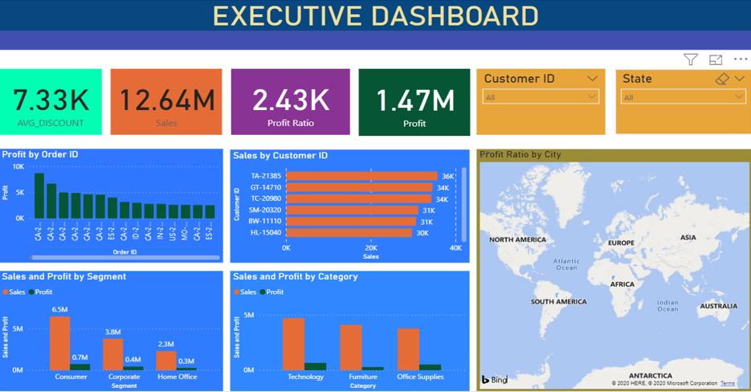
Project 2: Visualization using Power BI
Dashboards on Global Superstore dataset

Slide 6
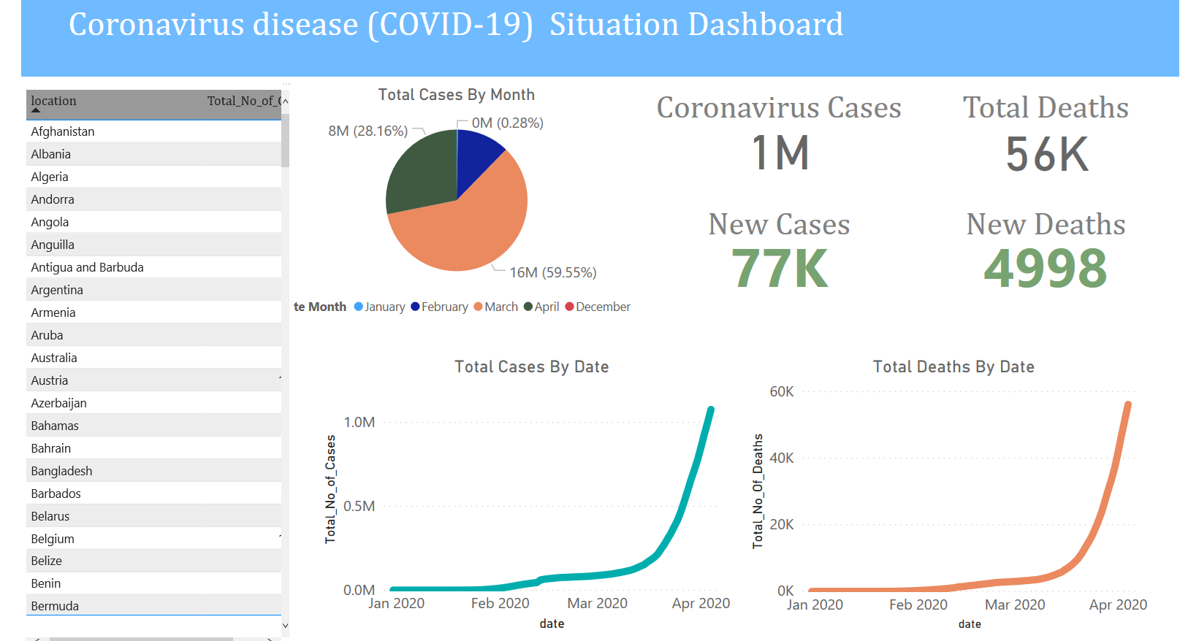
Integration of Python, SQL and Power-BI

Slide 7
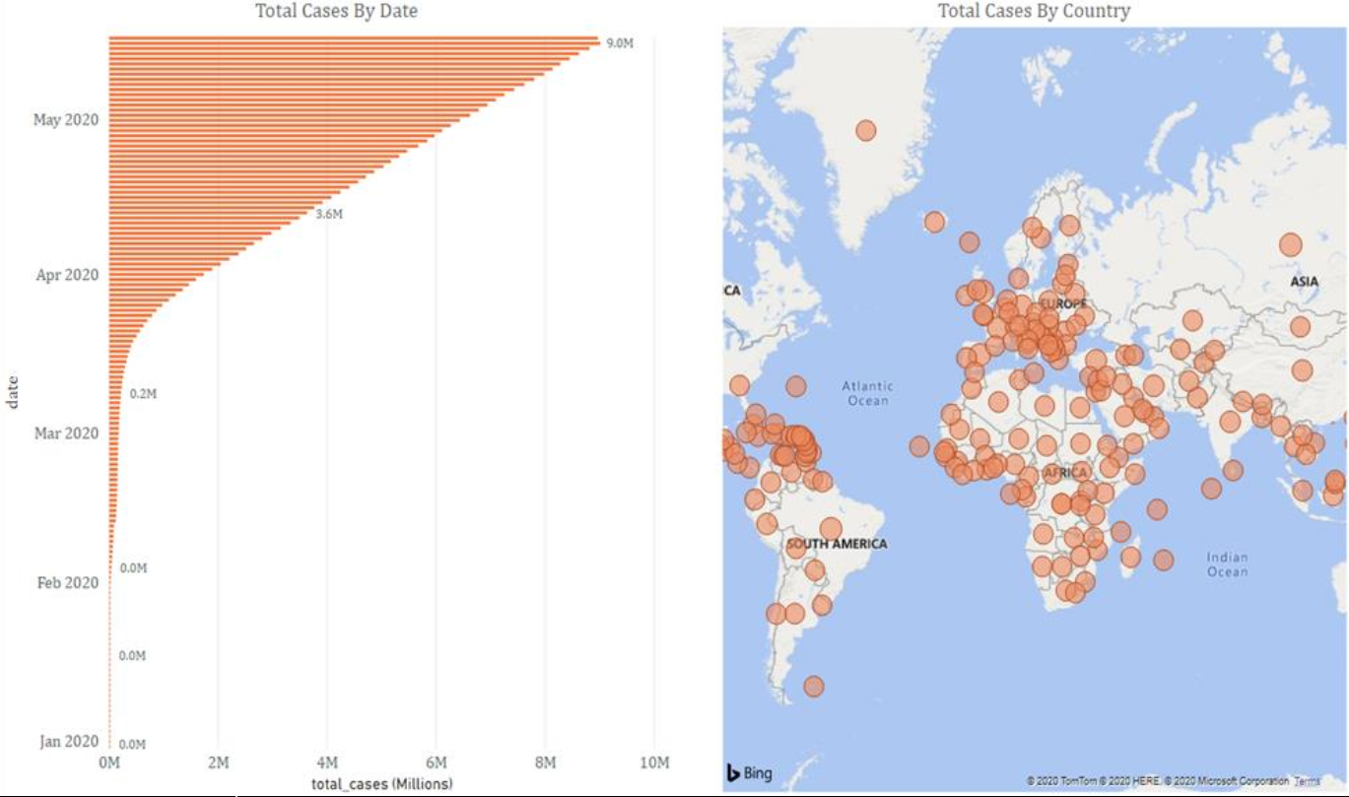

Slide 8
AWS:
Preparation of configuration files,
Preparation of templates for many stack creations,
Python code to post a request to a API,
Validation code,
Splunk,
Glue Jobs

Slide 9
Thank You

